Slide 1
Faculty of Health Sciences
Palacký University in Olomouc
Physiotherapy
Mgr. Lucie Sehnálková
Student Affairs Office, room 2.052
lucie.sehnalkova@upol.cz; +420 585 632 840

Slide 3
People of the Faculty
https://www.upol.cz/en/contacts/

Slide 4
FHS Structure
Dean
Dr. Jiří Vévoda
Vice-Dean for Internat. Relations
Vice-Dean for Doctoral Programmes
Vice-Dean for Stategic Management and Quality
Vice-Dean for Practical Training
Vice-Dean for Education and Life-long Learning
Clinical Rehabilitation Dept.
Nursing Dept.
Midwifery Dept.
Radiological Methods Dept.
Emergency Medicine and Intensive Care Dept.
FHS
Healthcare Management and Public Health Dept.

Slide 5
Department of Clinical Rehabilitation
Head of the Department of Clinical Rehabilitation | doc. MUDr. Petr Konečný, Ph.D., MBA.
Deputy Head | Mgr. Jana Vyskotová, Ph.D.
Head of the Physiotherapy study programme | Mgr. Petra Gaul Aláčová, Ph.D.
Secretary for English Study Programme of Physiotherapy | Ing. Markéta Nosková

Slide 6
Student Affairs Office
Mgr. Lucie Sehnálková | Student Affairs Officer for Physiotherapy study programme
lucie.sehnalkova@upol.cz | +420 585 632 840
Centre for Practical Training and Practical Teaching
Bc. Zuzana Pavlíková | Secretary of Centre for Practical Training and Practical Teaching
zuzana.pavlivkova@upol.cz | + 420 585 632 853

Slide 7
Portal & STAG
Course registration, timetables, exams, thesis…

Slide 8
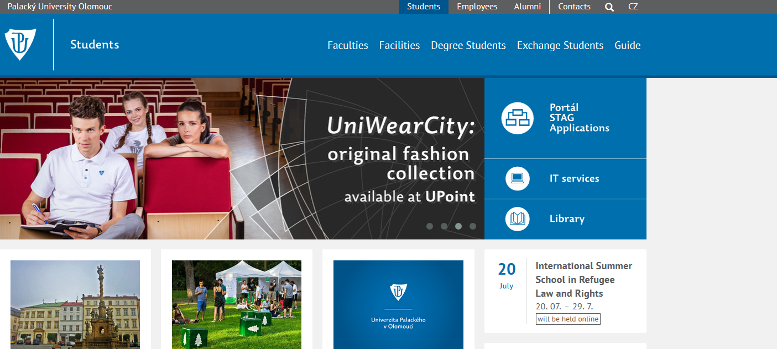
PORTAL: Palacký University Information System
https://portal.upol.cz/
Your User name and password can be found in the Electronic Application

Slide 9
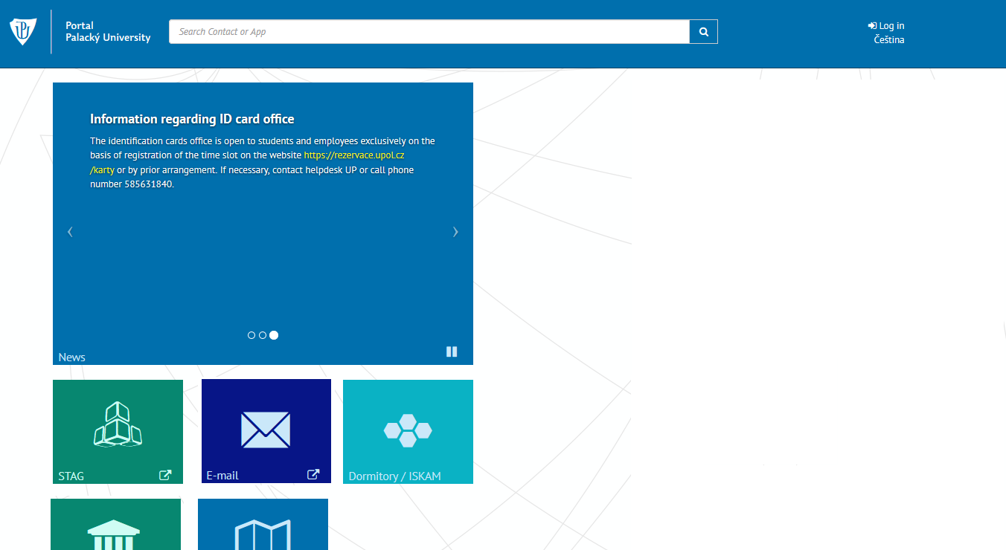
PORTAL: Palacký University Information System
https://portal.upol.cz/

Slide 10
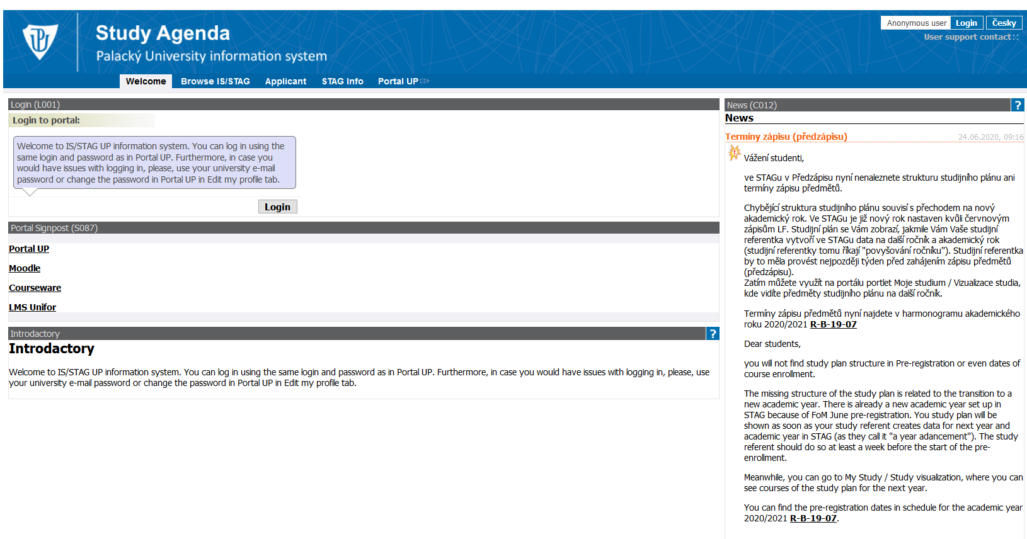
STAG: Study Agenda
https://stag.upol.cz/

Slide 11
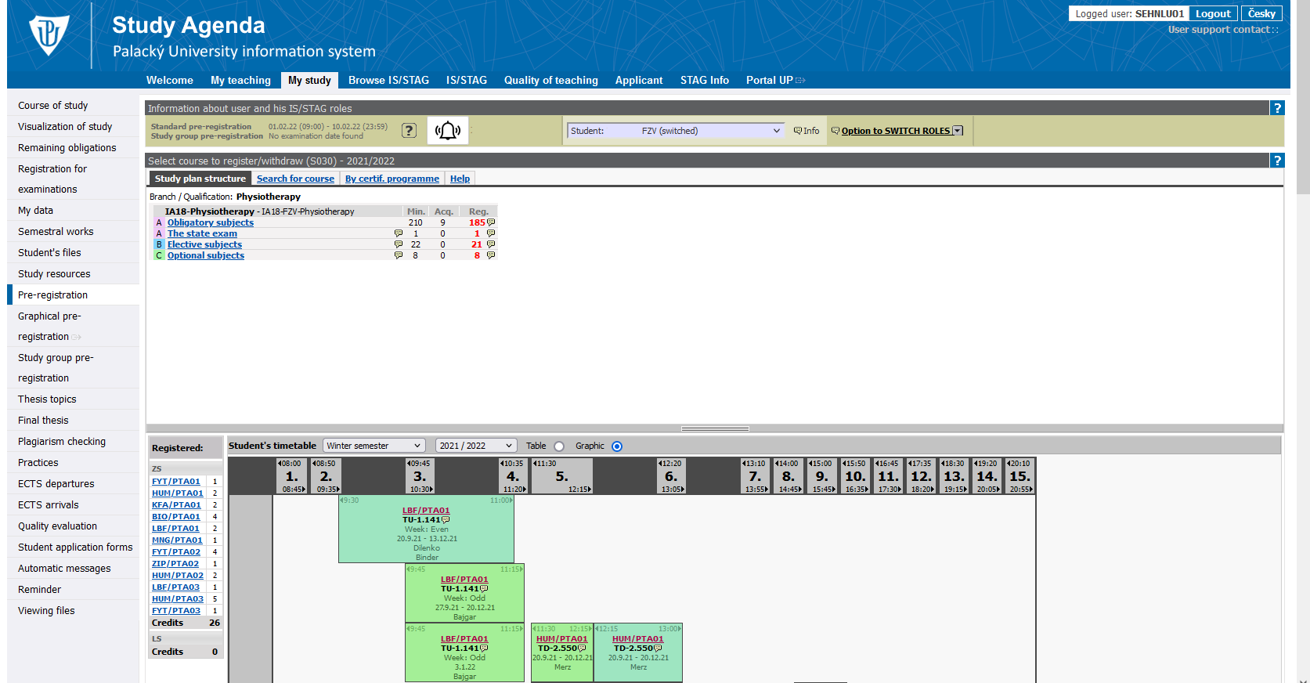
Pre-registration for courses
4th to 11th September 2023
Every course registration must be completed in STAG.
Registration for courses
Timetable

Slide 12
Courses – lectures, seminars and practicals
Obligatory course (A category) – students must pass all of the enlisted courses in this category during their study.
Elective course (B category) – students must acquire at least 22 credits by passing a corresponding number of courses during their study.
Optional course (C category) – students must acquire at least 8 credits by passing a corresponding number of courses during their study. The optional course can be any course from any faculty of our university.
The optimal number of credits per one academic year is 60 credits.
Student must acquire a minimum of 40 credits per one academic year.

Slide 13
Examinations and Re-sits
For all examination dates, register through STAG.
You have THREE attempts to pass an exam.
If you fail for the first time: first re-sit
If you fail for the second time: second re-sit
= usually a board examination
All non-completed courses of the previous academic year must be completed in the next academic year.
Examination period:
Winter semester: from 8th January to 9th February 2024
Summer semester: from 27th May to 30th June 2024

Slide 14
Checking the course of study
Deadline for the fulfillment of study requirements for the academic year 2023/2024 is
6th September 2024
The date of the Checking the course of study can be found on the Faculty website:
https://www.fzv.upol.cz/en/students/study-guide/important-dates/

Slide 15
Completion of study
Students must acquire during the whole course of study a minimum of 240 credits.
After the completion of the required courses, students may register for the Final State Exam and Thesis Defence.
The standard length of the Bc‘s study of Physiotherapy is 4 years.
The maximal length of study is 7 years (4 standard + 3 extended years).
Students of the foreign study programme are obliged to pay an annual tuition fee of 8.000,- EUR.

Slide 16
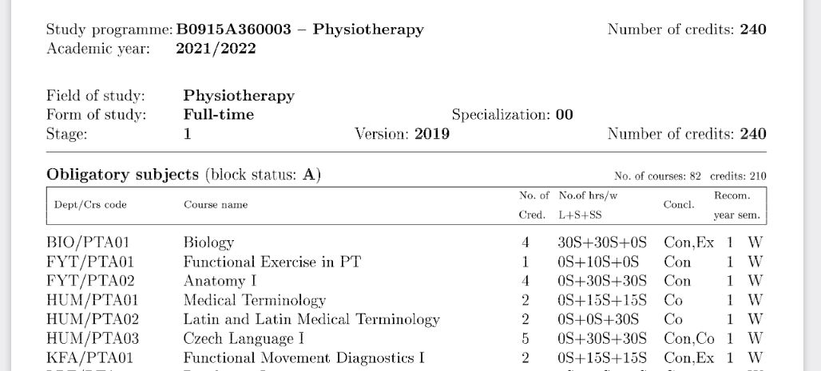
University Blue Book
FHS personnel (pp 5-7)
Departments of the FHS and Faculty of Medicine and Dentistry (pp 10-30)
Schedule of the academic year 2023/2024 (pp 32)
Physiotherapy study plan (pp 35-37) – also on the faculty website
UP Study and Examination Code link (pp 40)

Slide 17
Where to look for
information & help

Slide 18
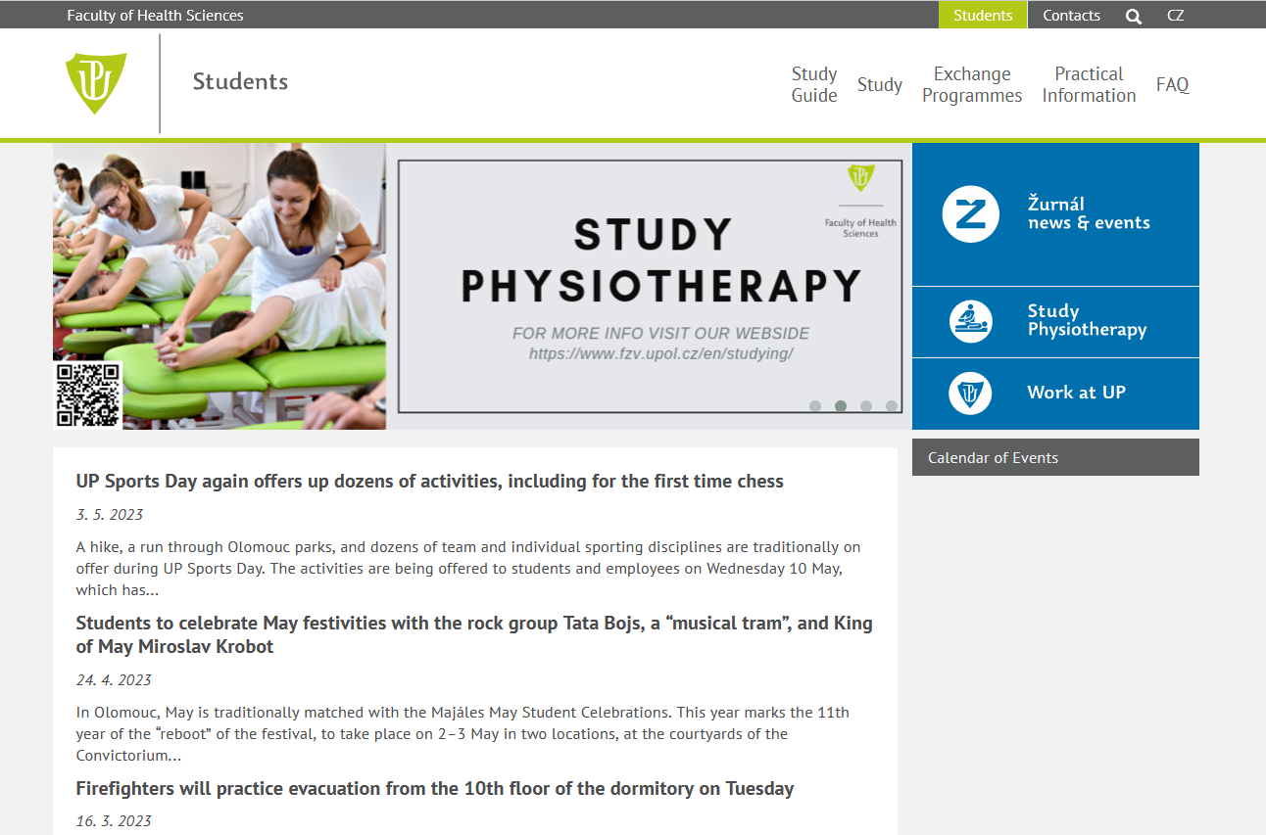
Faculty website https://www.fzv.upol.cz/en/students/

Slide 19
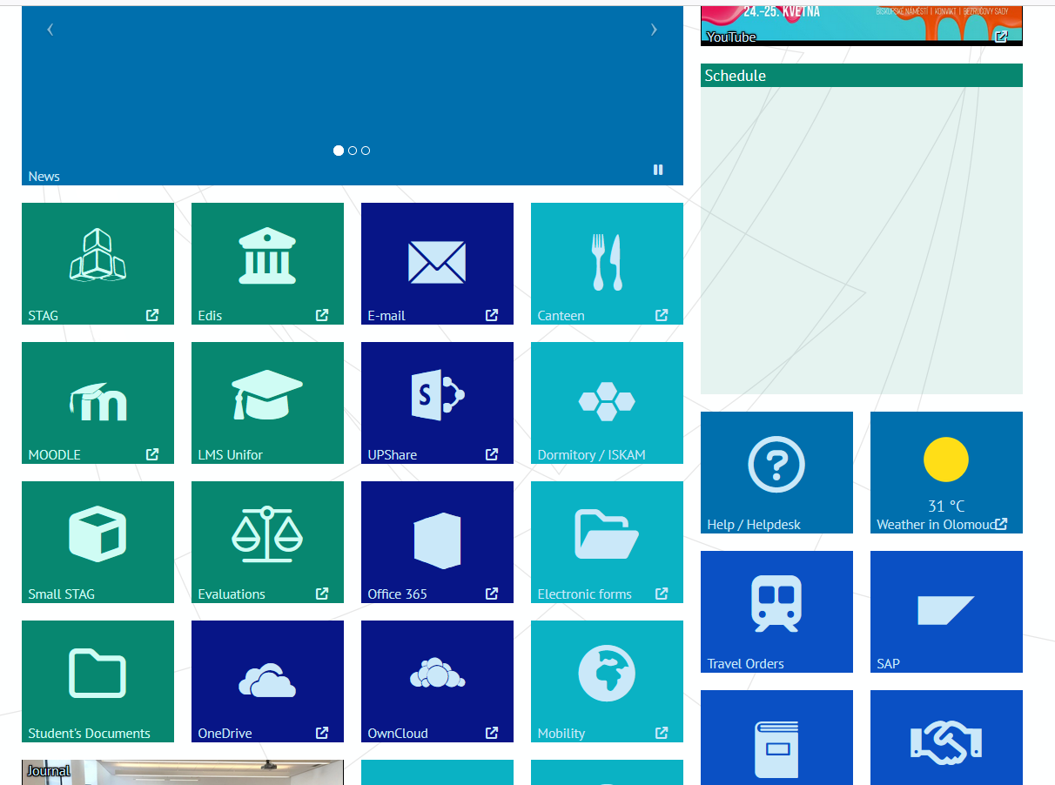
UP Portal https://portal.upol.cz/

Slide 20
Student University Email Outlook
Students are required to use their university email address when communication with the university personnel (teachers, officers, etc.).
Recommendation – set the forwarding of emails from the university email address to your personal email (see Setting).
Students receive important information on their university email address about deadlines, courses and exams. They are expected to check their university email address daily.
UP Newsletter

Slide 21
Student Card (ISIC) https://cvt.upol.cz/identifikacni-karty-ik/
Access to the University and Faculty Libraries, canteen and various other services of the university.
Student discounts in UPoint Shop, theatres, cinemas, and various shops.
Application process:
Fill and send the application in the electronic application with your photo attached. Pay for the card via bank transfer.
After receiving the email that your card is ready, book a date for collecting your card. You will receive a PIN code.
At the booked date, go to the IT Center on Biskupské Square 1 and use your PIN code to receive your student card.

Slide 22
UP Services https://www.fzv.upol.cz/en/students/
Welcome Office – helping foreign students with VISA and residence
Healthcare – free healthcare for students (GP, dentist, psychologist…)
Faculty library and university library Zbrojnice
School canteen
Clubs
Sports activities and clubs – Academic Sport Center
Student clubs – PEPA (club for international students of FHS and MF)
Support for students with special needs – https://cps.upol.cz/en/
Tutoring – Ariel Sherman (ariel.sherman01@upol.cz)
Buddies

Slide 23
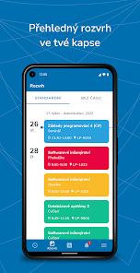
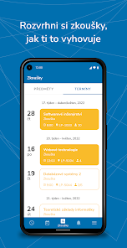
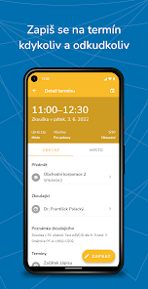
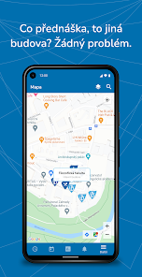
UPlikace
Available on Google Play
Create and manage your timetable
Sign up for exams and check your study results
Interactive map of all UP buildings, libraries, sport centers etc.

Slide 24
Orientation Day for International Students
11th September, 13:00
Information on:
VISA and resident cards
Insurance and how to solve problems
Study responsibilities (tuition fees, course registration, FAQ)
Healthcare
Life in Olomouc (part-time jobs, cultural events, help)

Slide 25
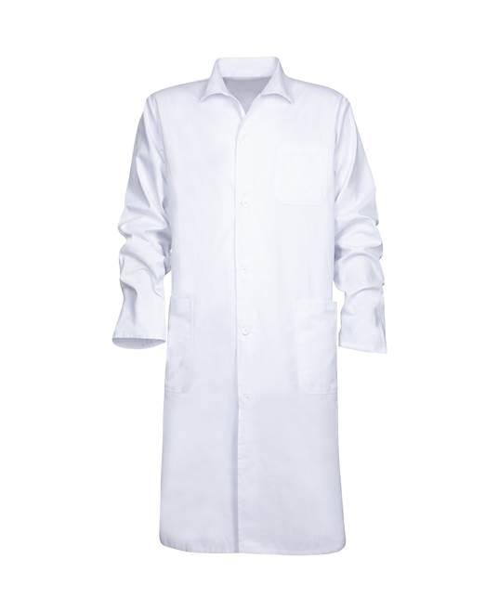
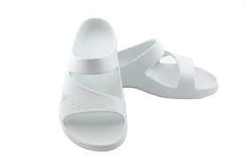
What to buy before the first class
UPoint university shop
Horní náměstí 12 (city center)
ARDON shop, Hněvotínská 54 (10 minutes from the university)
Medical supplies EMPOLAS, Globus shopping center
(10 mins from Neředín dorms)

Slide 26
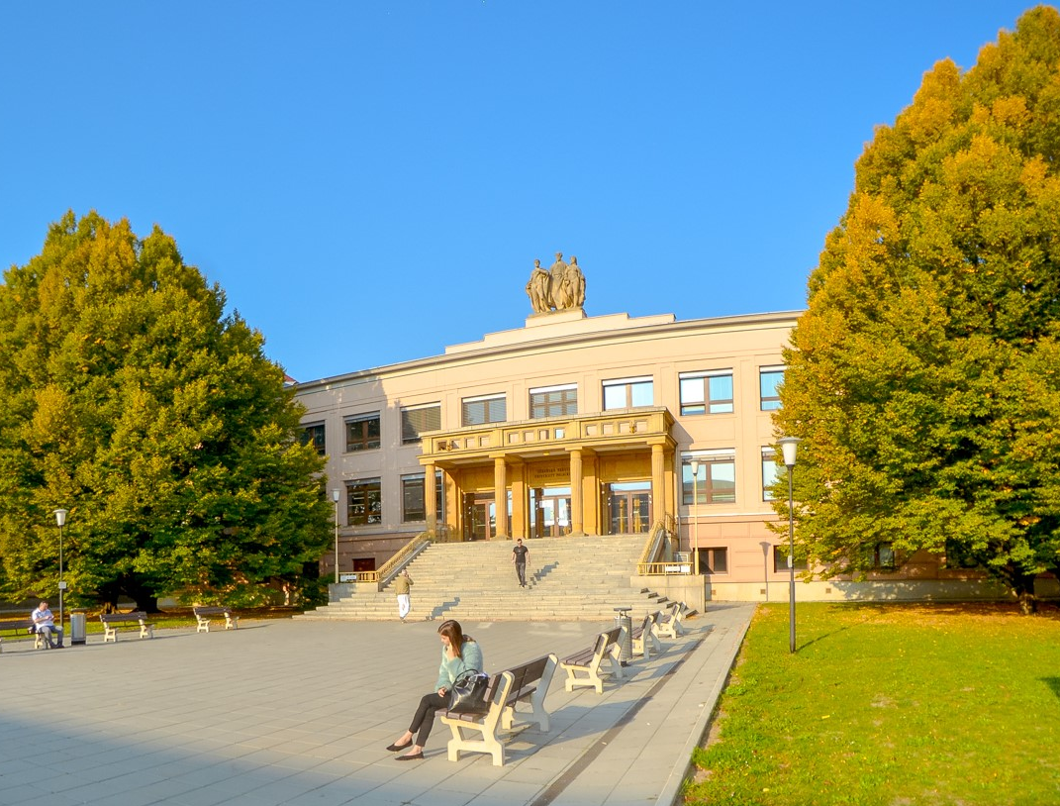
Good luck!

Slide 27
Time for questions

